Slide 1
Network Modelling
Lecture 10
Chapter 3: Optimization
Institute of Engineering
Asst. Prof. Anita Prajapati, Ph.D.
5 July 2023

Slide 2
Network Modeling
Chapter 5
5-<number>

Slide 3
Introduction
A number of business problems can be represented graphically as networks.
This chapter focuses on several types of network flow problems:
  Transshipment Problems
  Shortest Path Problems
  Maximal Flow Problems
  Transportation/Assignment Problems
  Generalized Network Flow Problems
We also consider a different type of network problem called the Minimum Spanning Tree Problem
5-<number>

Slide 4
Characteristics of Network Flow Problems
Network flow problems can be represented as a collection of nodes connected by arcs.
There are three types of nodes:
    Supply
    Demand
    Transshipment
We’ll use negative numbers to represent supplies and positive numbers to represent demand.
5-<number>

Slide 5
Transshipment Problem( Characteristics)
Transshipment nodes can both send to and receive from other nodes in the network.
Positive numbers represent the demand at a given node.
Negative numbers represent the supply available at a node
5-<number>

Slide 6
A Transshipment Problem:
The Bavarian Motor Company
+100
Boston
$30
$50
2
Newark
-200
1
+60
Columbus
3
$40
$40
$35
$30
Richmond
Atlanta
+80
+170
4
5
$25
$45
$50
$35
+70
Mobile
6
J'ville
-300
$50
7
5-<number>

Slide 7
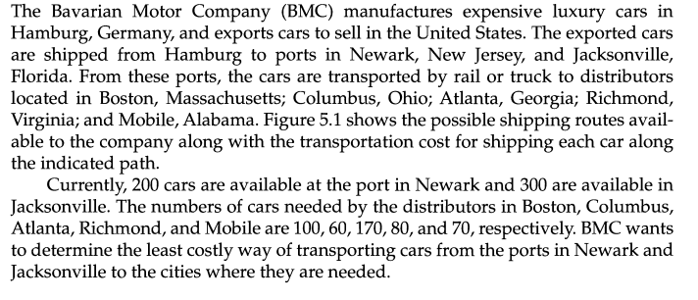
Transhipment Example
5-<number>

Slide 8
Defining the Decision Variables
For each arc in a network flow model
we define a decision variable as:
X_{ij} = the amount being shipped (or flowing) from node i to node j
For example,
X₁₂ = the number of cars shipped from node 1 (Newark) to node 2 (Boston)
X₅₆ = the number of cars shipped from node 5 (Atlanta) to node 6 (Mobile)
Note: The number of arcs determine the number of variables in a network flow problem!
The network in Figure contains 11 arcs. Therefore, the LP formulation of this model requires 11 decision variables
5-<number>

Slide 9
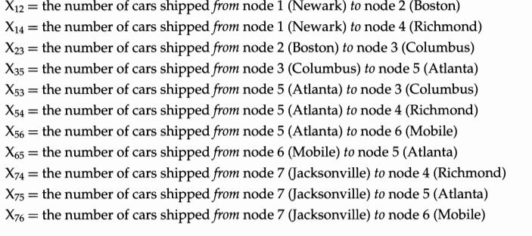
5-<number>

Slide 10
Defining the Objective Function
Minimize total shipping costs.
MIN: 30X₁₂ + 40X₁₄ + 50X₂₃ + 35X₃₅
+40X₅₃ + 30X₅₄ + 35X₅₆ + 25X₆₅
+ 50X₇₄ + 45X₇₅ + 50X₇₆
5-<number>

Slide 11
Constraints for Network Flow Problems:
The Balance-of-Flow Rules
For Minimum Cost Network Apply This Balance-of-Flow
Flow Problems Where: Rule At Each Node:
Total Supply > Total Demand Inflow-Outflow >= Supply or Demand
Total Supply < Total Demand Inflow-Outflow <=Supply or Demand
Total Supply = Total Demand Inflow-Outflow = Supply or Demand
5-<number>

Slide 12
Defining the Constraints
In the BMC problem:
  Total Supply = 500 cars
  Total Demand = 480 cars
So for each node we need a constraint of the form:
  Inflow - Outflow >= Supply or Demand
Constraint for node 1:
  –X₁₂ – X₁₄ >= -200 (there is no inflow for node 1!)
This is equivalent to:
  +X₁₂ + X₁₄ <= 200
5-<number>

Slide 13
Defining the Constraints
Flow constraints
  –X₁₂ – X₁₄ >= –200 } node 1
  +X₁₂ – X₂₃ >= +100 } node 2
  +X₂₃ + X₅₃ – X₃₅ >= +60 } node 3
  + X₁₄ + X₅₄ + X₇₄ >= +80 } node 4
  + X₃₅ + X₆₅ + X₇₅ – X₅₃ – X₅₄ – X₅₆ >= +170 } node 5
  + X₅₆ + X₇₆ – X₆₅ >= +70 } node 6
  –X₇₄ – X₇₅ – X₇₆ >= –300 } node 7
Non-negativity conditions
  X_{ij} >= 0 for all ij
5-<number>

Slide 14
Implementing the Model
See file Fig5-2.xls
5-<number>

Slide 15
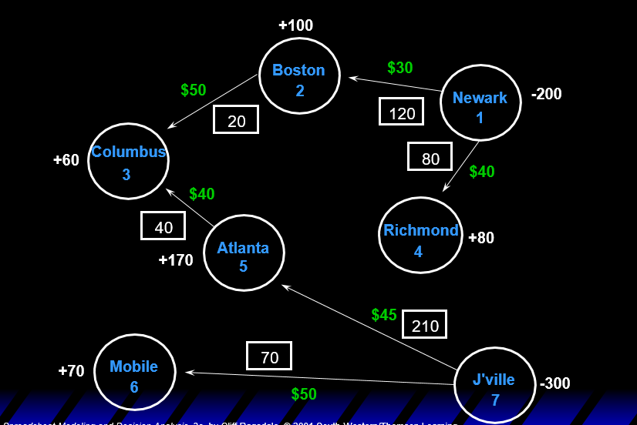
Optimal Solution to the BMC Problem
5-<number>

Slide 16
The Shortest Path Problem
Many decision problems boil down to determining the shortest (or least costly) route or path through a network.
  Ex. Emergency Vehicle Routing
This is a special case of a transshipment problem where:
    there is a supply node with a supply of -1
    there is a demand node with a demand of +1
    all other nodes have supply/demand of +0
5-<number>

Slide 17
The American Car Association
+0
3.3 hrs
L'burg
5 pts
+1
9
Va Bch
5.0 hrs
11
9 pts
2.0 hrs
4 pts
+0
4.7 hrs
2.7 hrs
9 pts
+0
4 pts
K'ville
1.1 hrs
G'boro
3 pts
5
2.0 hrs
3.0 hrs
Raliegh
9 pts
4 pts
8
10
+0
1.7 hrs
5 pts
A'ville
6
+0
1.5 hrs
+0
3 pts
2.3 hrs
Chatt.
3 pts
2.8 hrs
3
7 pts
2.0 hrs
Charl.
8 pts
7
+0
3.0 hrs
1.7 hrs
4 pts
4 pts
G'ville
1.5 hrs
2 pts
4
Atlanta
+0
B'ham
2
2.5 hrs
1
2.5 hrs
3 pts
3 pts
+0
-1
5-<number>

Slide 18
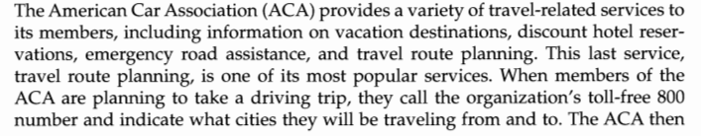
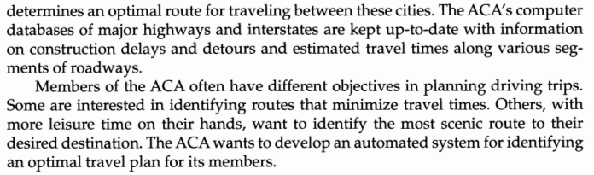
5-<number>

Slide 19
Solving the Problem
There are two possible objectives for this problem
  Finding the quickest route (minimizing travel time)
  Finding the most scenic route (maximizing the scenic rating points)
See file Fig5-7.xls
5-<number>

Slide 20
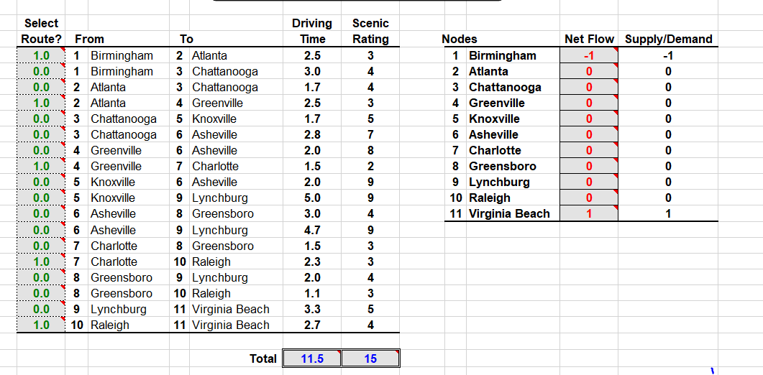
Minimum Driving Time
5-<number>

Slide 21
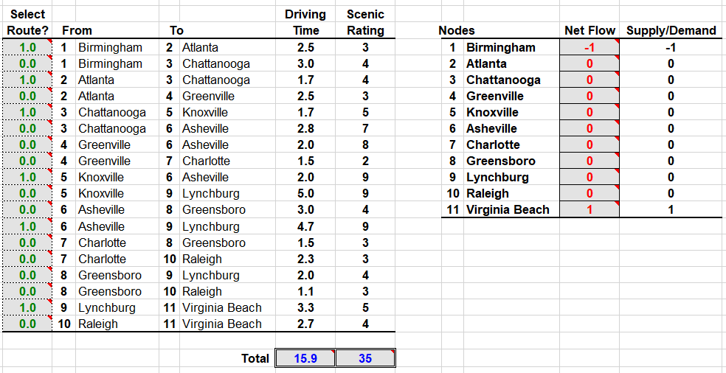
Maximize scenic rating
5-<number>

Slide 22
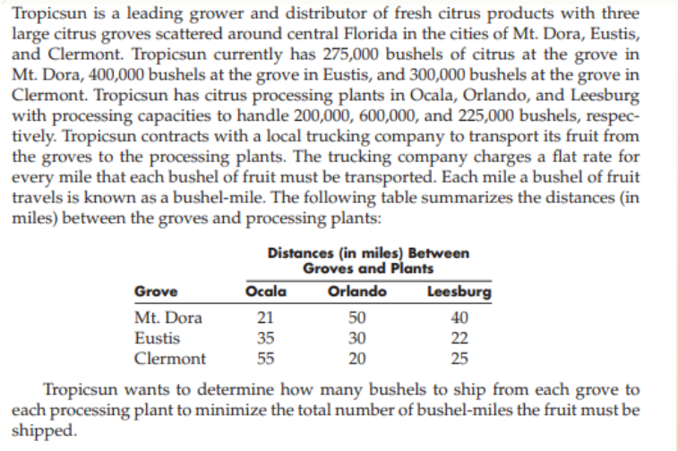
Transportation & Assignment Problems
5-<number>

Slide 23
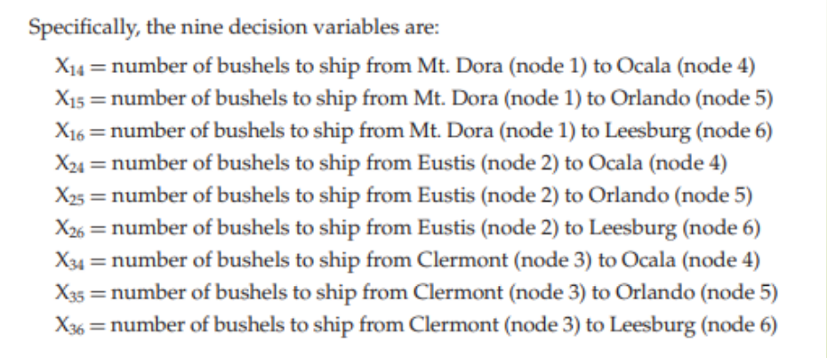
5-<number>

Slide 24
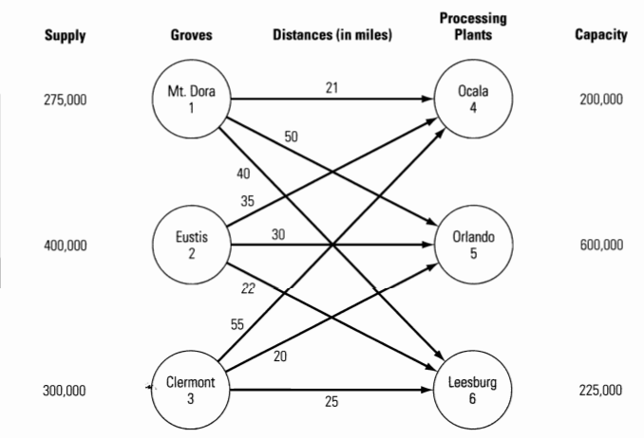
Graphical Representation
Some network flow problems don’t have trans-shipment nodes; only supply and demand nodes.
These problems are implemented more effectively using the technique described in Chapter 3.
5-<number>

Slide 25
Objective Function
The goal in this problem is to determine how many bushels to ship from each grove to each processing plant while minimizing the total distance (or total number of bushel miles) the fruit must travel
5-<number>

Slide 26
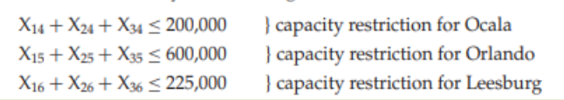
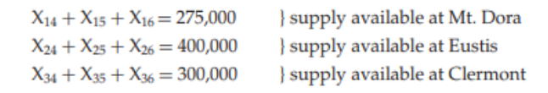
Two physical constraint
First, there is a limit on the amount of fruit that can be shipped to each processing plant. Tropicsun can ship no more than 200,000, 600,000, and 225,000 bushels to Ocala, Orlando, and Leesburg, respectively. So,
The second set of constraints ensures that the supply of fruit at each grove is shipped to a processing plant. That is, all of the 275,000, 400,000, and 300,000 bushels at Mt. Dora, Eustis, and Clermont, respectively, must be processed somewhere. So,
5-<number>

Slide 27
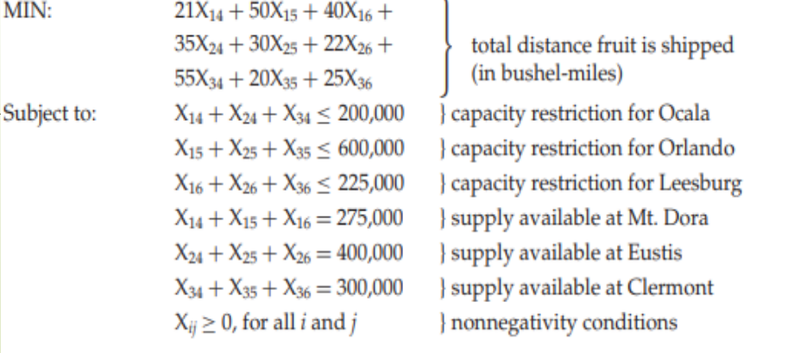
Model
5-<number>

Slide 28
Generalized Network Flow Problems
In some problems, a gain or loss occurs in flows over arcs.
  Examples
    Oil or gas shipped through a leaky pipeline
    Imperfections in raw materials entering a production process
    Spoilage of food items during transit
    Theft during transit
    Interest or dividends on investments
These problems require some modeling changes.
5-<number>

Slide 29
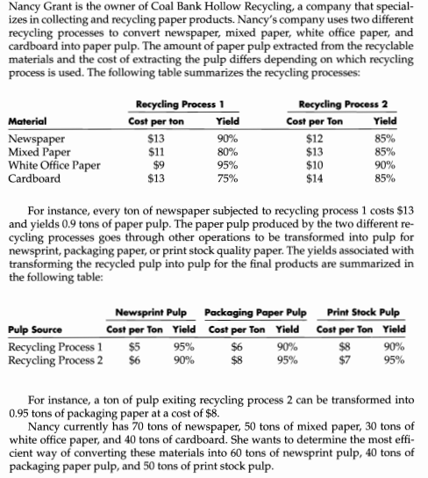
5-<number>

Slide 30
Coal Bank Hollow Recycling
Recycling Process 1 Recycling Process 2
Material Cost Yield Cost Yield Supply
Newspaper $13 90% $12 85% 70 tons
Mixed Paper $11 80% $13 85% 50 tons
White Office Paper $9 95% $10 90% 30 tons
Cardboard $13 75% $14 85% 40 tons
Newsprint Packaging Paper Print Stock
Pulp Source Cost Yield Cost Yield Cost Yield
Recycling Process 1 $5 95% $6 90% $8 90%
Recycling Process 2 $6 90% $8 95% $7 95%
Demand 60 tons 40 tons 50 tons
5-<number>

Slide 31
Network for Recycling Problem
-70
Newspaper
$13
1
$12
95%
Newsprint
90%
+0
+60
pulp
80%
$5
7
-50
Mixed
$11
Recycling
90%
paper
95%
Process 1
$6
2
5
$13
$8
90%
75%
Packing
paper
+40
pulp
White
$9
85%
95%
8
-30
office
85%
paper
$6
3
$10
90%
Recycling
$8
90%
Process 2
6
$7
Print
85%
stock
+50
$13
+0
95%
pulp
9
-40
Cardboard
$14
4
5-<number>

Slide 32
Defining the Objective Function
Minimize total cost.
MIN: 13X₁₅ + 12X₁₆ + 11X₂₅ + 13X₂₆
+ 9X₃₅+ 10X₃₆ + 13X₄₅ + 14X₄₆ + 5X₅₇ + 6X₅₈ + 8X₅₉ + 6X₆₇ + 8X₆₈ + 7X₆₉
5-<number>

Slide 33
Defining the Constraints
Raw Materials
  -X₁₅ -X₁₆ >= -70 } node 1
  -X₂₅ -X₂₆ >= -50 } node 2
  -X₃₅ -X₃₆ >= -30 } node 3
  -X₄₅ -X₄₆ >= -40 } node 4
Recycling Processes
  +0.9X₁₅ +0.8X₂₅ +0.95X₃₅ +0.75X₄₅ -X₅₇ -X₅₈ -X₅₉ >= 0 } node 5
  +0.85X₁₆ +0.85X₂₆ +0.9X₃₆ +0.85X₄₆ -X₆₇ -X₆₈ -X₆₉ >= 0 } node 6
Paper Pulp
  +0.95X₅₇ +0.90X₆₇ >= 60 } node 7
  +0.90X₅₇ +0.95X₆₇ >= 40 } node 8
  +0.90X₅₇ +0.95X₆₇ >= 50 } node 9
5-<number>

Slide 34
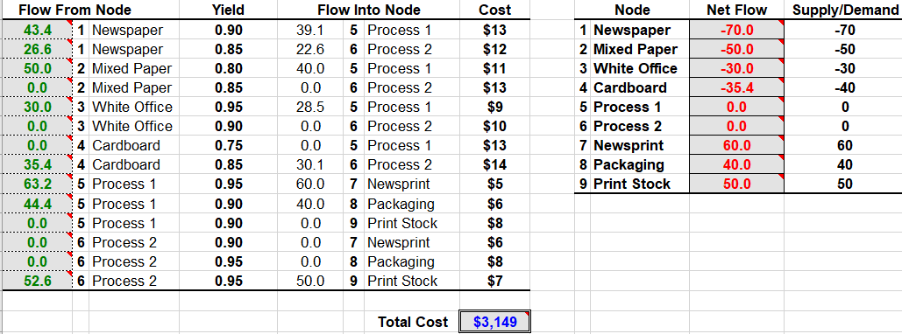
Implementing the Model
See file Fig5-17.xls
5-<number>

Slide 35
The Maximal Flow Problem
In some network problems, the objective is to determine the maximum amount of flow that can occur through a network.
The arcs in these problems have upper and lower flow limits.
Examples
  How much water can flow through a network of pipes?
  How many cars can travel through a network of streets?
5-<number>

Slide 36
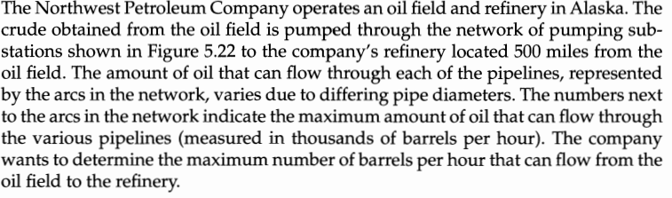
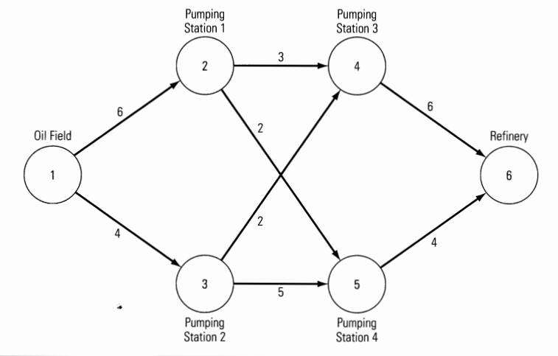
5-<number>

Slide 37
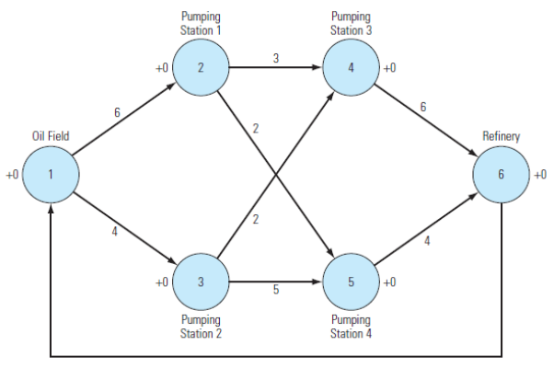
Maximal Flow Problem (Adding Return Arc)
5-<number>

Slide 38
Formulation of the Max Flow Problem
MAX: X₆₁
Subject to: +X₆₁ - X₁₂ - X₁₃ = 0
+X₁₂ - X₂₄ - X₂₅ = 0
+X₁₃ - X₃₄ - X₃₅ = 0
+X₂₄ + X₃₄ - X₄₆ = 0
+X₂₅ + X₃₅ - X₅₆ = 0
+X₄₆ + X₅₆ - X₆₁ = 0
with the following bounds on the decision variables:
0 <= X₁₂ <= 6 0 <= X₂₅ <= 2 0 <= X₄₆ <= 6
0 <= X₁₃ <= 4 0 <= X₃₄ <= 2 0 <= X₅₆ <= 4
0 <= X₂₄ <= 3 0 <= X₃₅ <= 5 0 <= X₆₁ <= inf
5-<number>

Slide 39
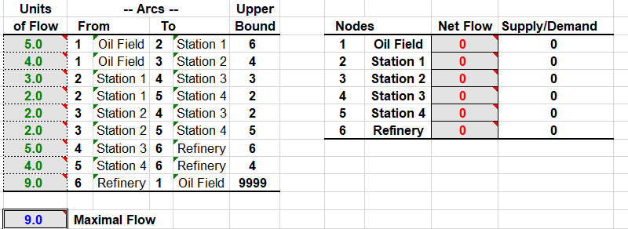
Implementing the Model
See file Fig5-24.xls
5-<number>

Slide 40
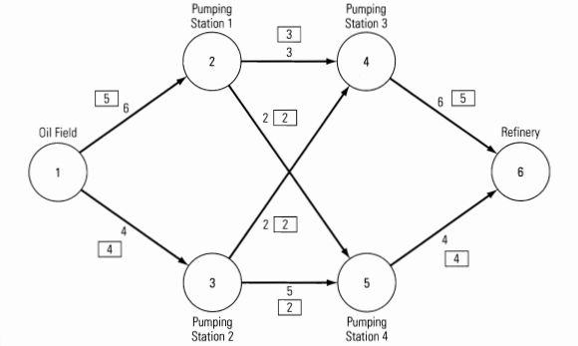
Optimal Solution
5-<number>

Slide 41
The Minimal Spanning Tree Problem
For a network with n nodes, a spanning tree is a set of n-1 arcs that connects all the nodes and contains no loops.
The minimal spanning tree problem involves determining the set of arcs that connects all the nodes at minimum cost.
5-<number>

Slide 42
Assignment 5
Question no: 9, 11, 14, 16, 17, 18, 21, 23, 27, 30
Due on 14 July
5-<number>

Slide 43
End of Chapter 5
5-<number>

